Slide 1


Practical Machine Learning
Organization
Notes:
https://www.pexels.com/photo/woman-typing-on-laptop-7112/

Slide 2
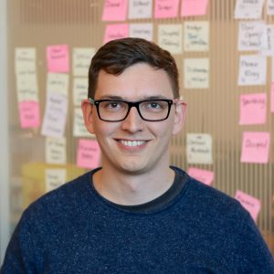
Team
Sven Mayer
Jesse Grootjen
Maximiliane Windl

Slide 3
Organization
Lecture: Thursday 10-12 c.t., Zoom
Tutorials: Fridays 10-12 c.t., Zoom
Location: Pettenkoferstr. 14, Kl. HS Physiologie (F1.08)
Practical projects: one (iteration of a) practical project over the course of the lecture; intermediate presentations in the tutorials and final presentation at the end of the lecture

Slide 4
Organization
Uni2Work course (course organization and news):
https://uni2work.ifi.lmu.de/course/S22/IfI/PML
Website http://www.medien.ifi.lmu.de/lehre/ss22/pml/
Recordings & Slides https://sven-mayer.com/pml
Discord (see Uni2Work)
Email pml@medien.ifi.lmu.de

Slide 5
Recorded Lecture
The materials are online available via
https://sven-mayer.com/pml/
Watch the lecture recording before the lecture
Videos 20min to 1h
In the lecture slot (Thursdays, 10-12) we will discuss the content
No playback of the recorded lecture materials
Discussion lectures will be every two weeks
Watch the videos, have questions, and engage in the discussion

Slide 6
Organization
Hands-On Sessions
You will get all information in the first tutorial.
Examples will be based on
Python 3.9
Keras + Tensoflow
Jupyter Notebooks recommended
Get started:
https://www.python.org/
https://www.tensorflow.org/install
https://jupyter.org/
For Windows users: https://www.lfd.uci.edu/~gohlke/pythonlibs/

Slide 7
Exam
The exam will consist of two parts
Your practical project including the final presentation (1/2 of the final grade)
An oral exam of 10 minutes about the content of the lectures, exercises, and project (1/2 of the final grade)
Note: You have to pass both parts individually. To pass overall.
This lecture has 6 ETCS which is equivalent to 180h of work

Slide 8
Exam
Oral
10 minutes oral exam in the semester break
Oral exams will be in person
Dates: TBA
Notes:
t

Slide 9
Exam
Projects
Groups of 3-5 students
10 min presentation at the end of the semester
During the Lecture and tutorial slot
Submit in your code and materials via Uni2Work
“Statement of Contribution” max 2 page
to represent the contribution of all parties
Notes:
t

Slide 10
Lectures
28.04.2022 Lecture 01: Organization & Introduction
05.05.2022 Lecture 02: Supervised vs. Unsupervised Learning & Lecture 03: Full Practical Neural Network Walkthrough
12.05.2022 canceled
19.05.2022 Lecture 04: Introduction Neural Networks & Lecture 05: Advanced Neural Networks
26.05.2022 canceled - public holiday
02.06.2022 Lecture 06: Evaluating Neural Networks & Lecture 07: Trainings Strategies
09.06.2022 Lecture 08: Recurrent Neural Network (RNN) & Long Short-Term Memory (LSTM)
16.06.2022 canceled - public holiday
23.06.2022 Lecture 09: Generative Adversarial Networks (GANs)
30.06.2022 Lecture 10: Reinforcement Learning
07.07.2022 Lecture 11: TBA
14.07.2022 canceled
21.07.2022 Open Discussion
28.07.2022 Final Presentation

Slide 11
Tutorials
06.05.2022 Organization & Exercise 01: Recording your own data (2 weeks)
13.05.2022 Live Coding Session: Getting Started with Neuronal Networks
20.05.2022 Live Coding Session: Deploying Models to Mobile Devices (Android) & Exercise 02: Clearning your data and traing the first model (2 weeks)
27.05.2022 canceled
03.06.2022 Project Ideation & Exercise 03: Training an improved model based on a large dataset (1 weeks)
10.06.2022 Project Pitches: Show Current Project Status
17.06.2022 Individual Help for Projects
24.06.2022 Individual Help for Projects
01.07.2022 Individual Help for Projects
08.07.2022 Individual Help for Projects
15.07.2022 canceled
22.07.2022 How to give a great project presentation & Q'n'A: Exam preparation &Individual Help for Projects
29.07.2022 Final Presentation
Projects

Slide 12
Projects
Goals
The goal is to apply machine learning in the context of human-computer interaction
Be creative – think about sensors, e.g., IMU, camera, EEG
Do not try to improve on existing systems
Recording enough data for ML is hard
Preexisting datasets can help

Slide 13
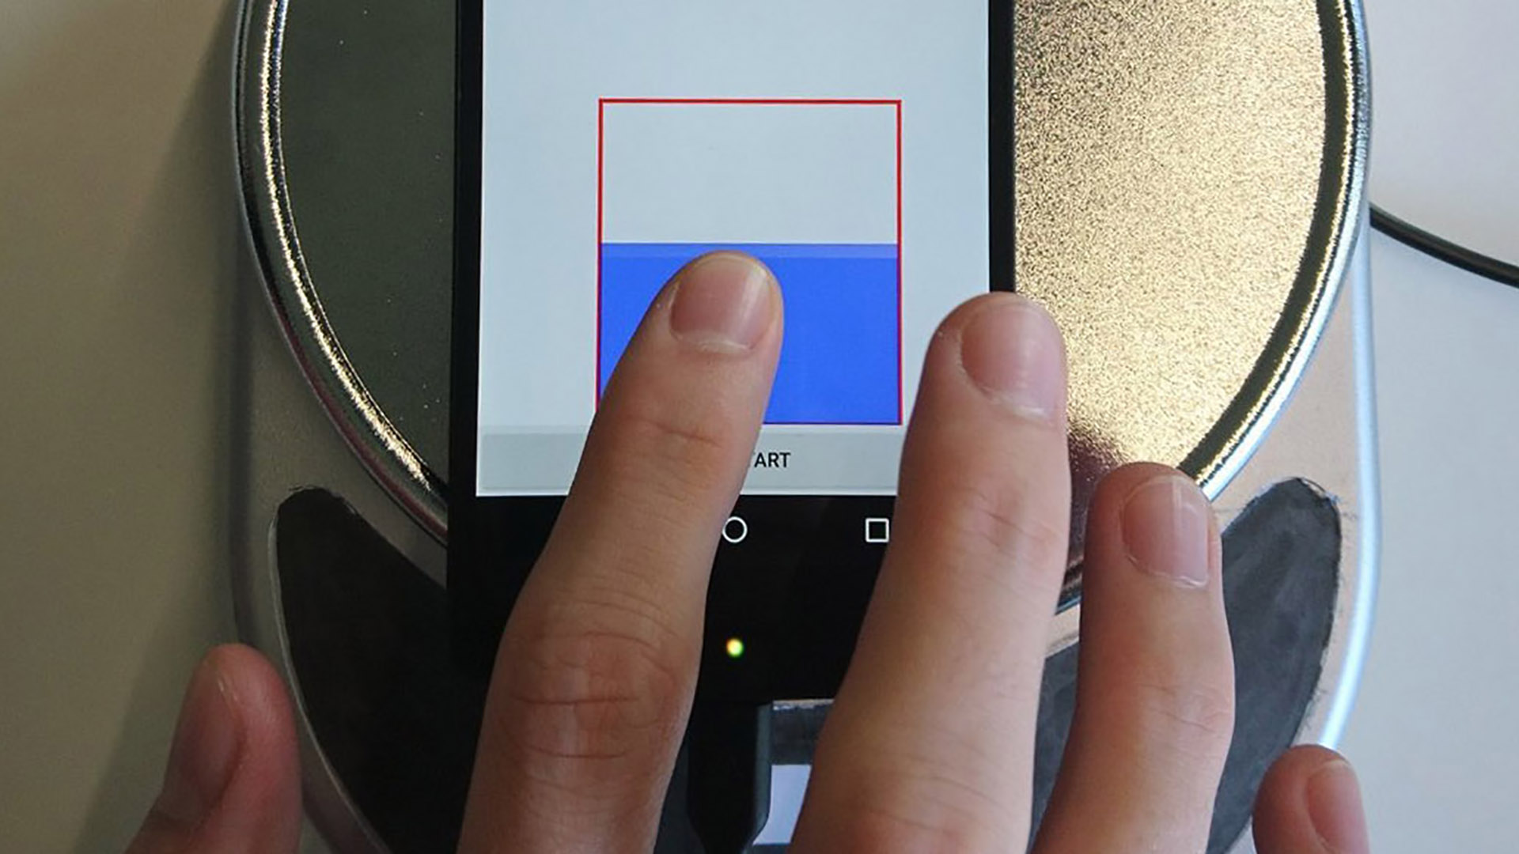
Projects Outcomes
Force Touch Detection on Capacitive Sensors using Deep Neural Networks
Tobias Boceck, Sascha Sprott, Huy Viet Le, and Sven Mayer. 2019. Force Touch Detection on Capacitive Sensors using Deep Neural Networks. In Procc of MobileHCI ‘19. ACM. DOI: https://doi.org/10.1145/3338286.3344389

Slide 14
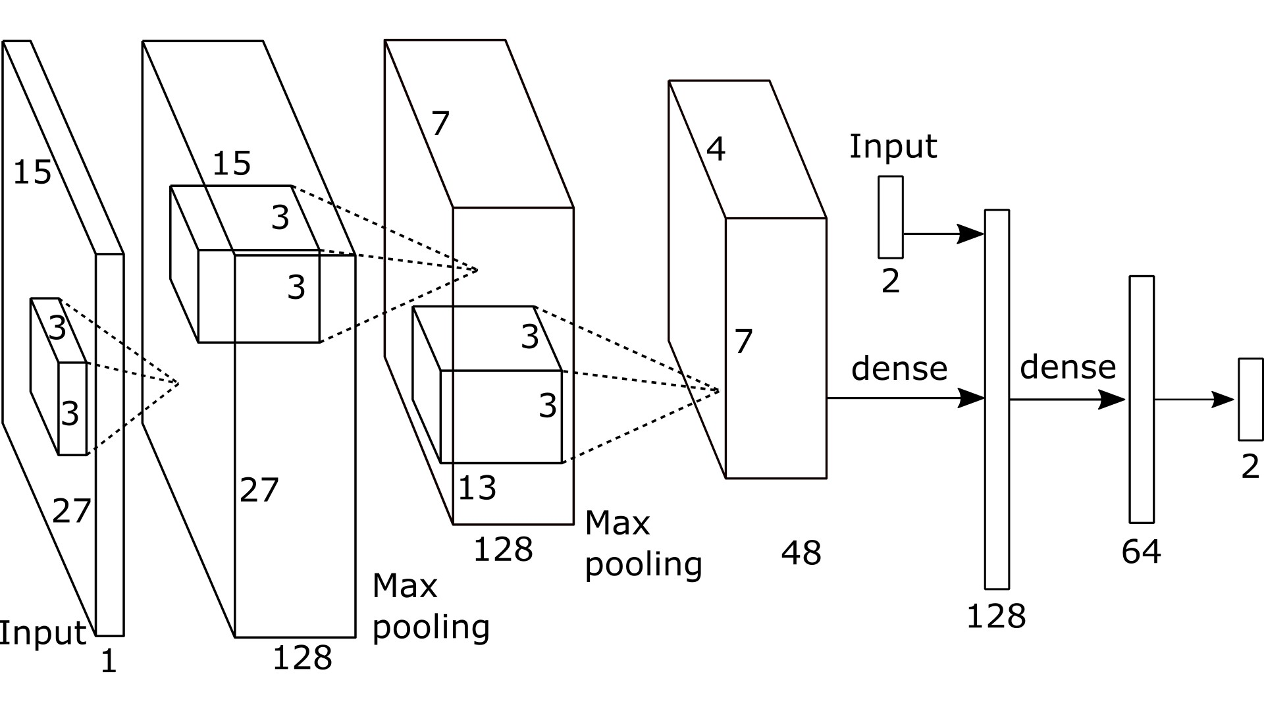
Projects Outcomes
Improving the Input Accuracy of Touchscreens using Deep Learning
Abinaya Kumar, Aishwarya Radjesh, Sven Mayer, and Huy Viet Le. 2019. Improving the Input Accuracy of Touchscreens using Deep Learning. In CHI EA '19. ACM. DOI: https://doi.org/10.1145/3290607.3312928

Slide 15
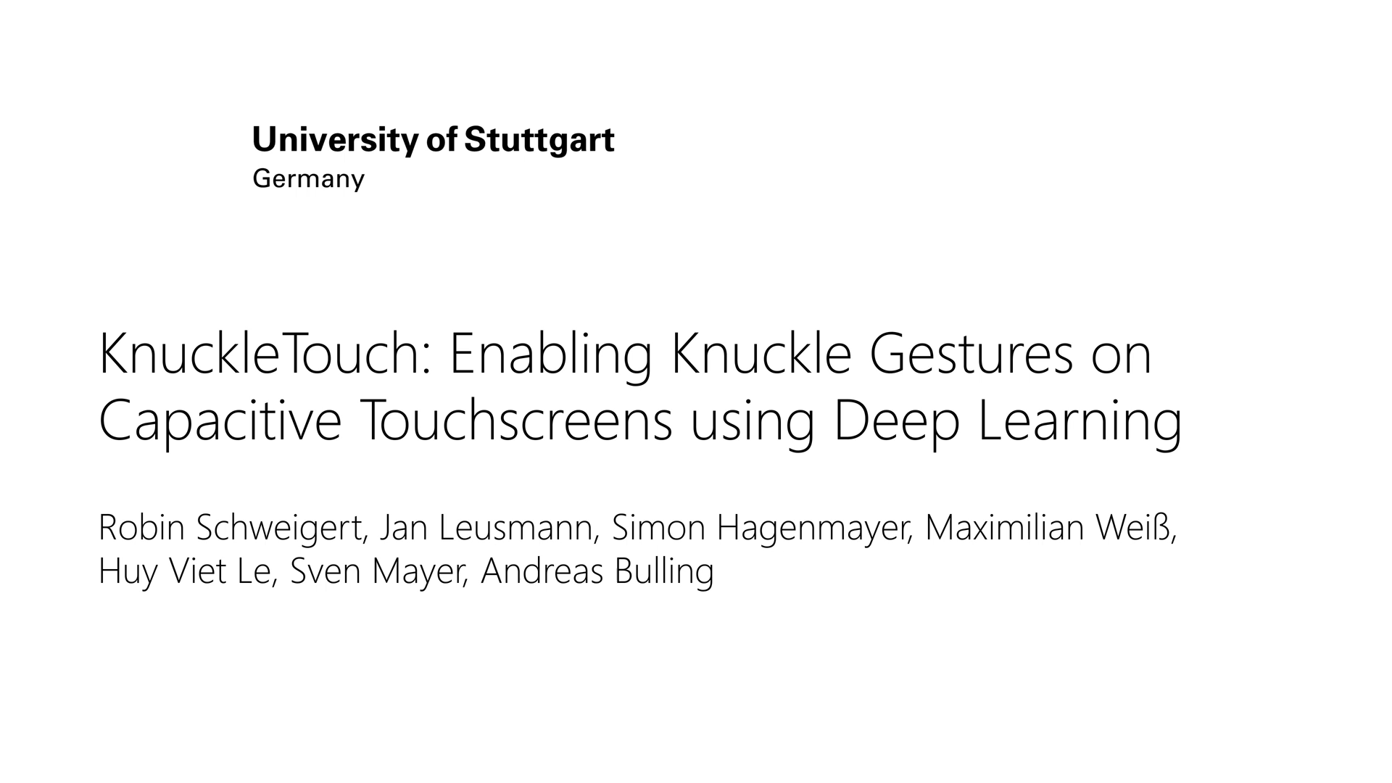
Projects Outcomes
KnuckleTouch: Enabling Knuckle Gestures on Capacitive Touchscreens using Deep Learning
Robin Schweigert, Jan Leusmann, Simon Hagenmayer, Maximilian Weiß, Huy Viet Le, Sven Mayer, and Andreas Bulling. 2019. KnuckleTouch: Enabling Knuckle Gestures on Capacitive Touchscreens using Deep Learning. In Proceedings of MuC'19. ACM, New York, NY, USA, 387–397. DOI: https://doi.org/10.1145/3340764.3340767

Slide 16
Questions?

Slide 17

License
This file is licensed under the Creative Commons Attribution-Share Alike 4.0 (CC BY-SA) license:
https://creativecommons.org/licenses/by-sa/4.0
Attribution: Sven Mayer

